Slide 2
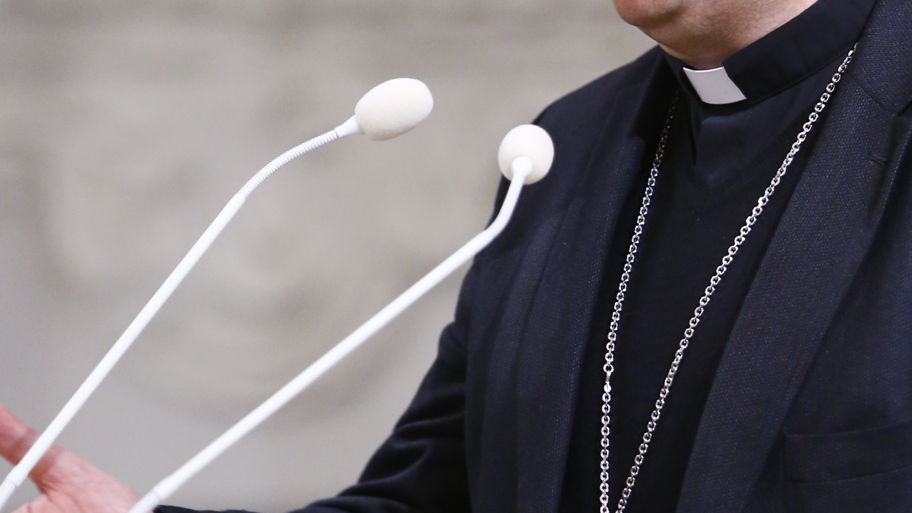
the dangers of
Clericalism
Ephesians 4:11-16
Notes:
There is a problem that has afflicted the Catholic church for centuries. It is called Clericalism.
I want to talk about it for a while today, and make clear that the attitudes that come from it can affect us as well.
First, there is a need to define a few things, and explain a few things about the Catholic Church

Slide 3
Definitions
Clergy - a group ordained to perform pastoral or sacerdotal functions in a Christian church
Laity - the people of a religious faith as distinguished from its clergy
Exodus 29:9; 1 Peter 2:4, 9-10; Romans 12:1-2
Notes:
The Catholic church is divided into two basic groups – The clergy, and the laity
Clergy – a group ordained to perform pastoral or sacerdotal functions in a Christian church
Laity - the people of a religious faith as distinguished from its clergy (in other words – everyone else)
A similar division existed during Moses time, as you had the Priesthood distinguished from the rest of Israel
The family of Aaron, of the tribe of Levi, were set apart as clergy (those responsible for the sacrificial & ministerial duties of the nation)
(Exodus 29:9), “And you shall gird them with sashes, Aaron and his sons, and put the hats on them. The priesthood shall be theirs for a perpetual statute. So you shall consecrate Aaron and his sons.”
This division has been done away with in Christ
In Christ Jesus, He is the high priest, but each and every Christian is a priest (set apart for holy service)
(1 Peter 2:4), “Coming to Him as to a living stone, rejected indeed by men, but chosen by God and precious, ⁵ you also, as living stones, are being built up a spiritual house, a holy priesthood, to offer up spiritual sacrifices acceptable to God through Jesus Christ.”
(1 Peter 2:9-10), “But you are a chosen generation, a royal priesthood, a holy nation, His own special people, that you may proclaim the praises of Him who called you out of darkness into His marvelous light; ¹⁰ who once were not a people but are now the people of God, who had not obtained mercy but now have obtained mercy.”
In Christ Jesus, every Christian offers up sacrifices to God
(Romans 12:1-2), “I beseech you therefore, brethren, by the mercies of God, that you present your bodies a living sacrifice, holy, acceptable to God, which is your reasonable service. ² And do not be conformed to this world, but be transformed by the renewing of your mind, that you may prove what is that good and acceptable and perfect will of God.”
Our sanctified life (life of holiness) is a sacrifice we offer to God
When we sing songs of praise to him, and pray to him, we are offering a sacrifice with our lips (cf. Hebrews 13:14-15)
When we give of our means in support of the gospel of Christ or for works of benevolence, we offer a sacrifice (Philippians 4:18; 2 Corinthians 8:1-5)
Therefore, the existence of the clergy laity distinction, present in so many churches today, has no scriptural basis or authority
It had its adoption in the Catholic church, perhaps imitating the Levitical priesthood under the Old Covenant
This clergy/laity distinction has been copied by most protestant denominations as well
It not only has no scriptural basis, it has led to the adoption of clericalism as a popular mindset. So, what is clericalism?

Slide 4
Clericalism
Defined: a policy of maintaining or increasing the power of a religious hierarchy
Problem: as the difference between clergy and laity becomes more pronounced, the importance of devotion and consecrated living on the part of the laity is deemphasized
Notes:
Clericalism – The actual definition does not fully describe the way the term is being used in the Catholic church to identify a problem experienced in that denomination
Definition - a policy of maintaining or increasing the power of a religious hierarchy
Problem - as the difference between clergy and laity becomes more pronounced, the importance of devotion and consecrated living on the part of the laity is deemphasized
Clergy gets a sense of superiority, and desires more to increase and consolidate power than to do what is right.
The Laity considers the Clergy as being holy, and that it is their place to “be religious”, where “we” live in the “real world”, and have little need to concern ourselves with spiritual matters.
This attitude was present in the days of Jesus, as the religious leaders opposed Him as they sought to maintain their power over the people.
The Pharisees certainly considered themselves to be more spiritually minded than other Jews (and it seems that many common Jews had the same conception)
(Luke 18:11-12), “The Pharisee stood and prayed thus with himself, ‘God, I thank You that I am not like other men—extortioners, unjust, adulterers, or even as this tax collector. ¹² I fast twice a week; I give tithes of all that I possess.’”
In the Catholic church, it is evident. And, so much a problem that the second Vatican Council convened in 1962 in an attempt to renew the dedication of the Catholic laity as they perceived the church was suffering from the mindset of Clericalism

Slide 5
Clericalism
Deeply ingrained, this way of thinking persists. In a recent review in the London Tablet one finds the religious affairs correspondent of the London Times disparaging lay groups which encourage people to aspire to sanctity (“high pressure and rarified religiosity… salvation by the fast lane”). Better for the laity, he writes, to “travel without the heavenly overdrive on full power every minute of every day.” Leaving aside the glitzy rhetoric, this constitutes a rationale for mediocrity as the appropriate model for lay spirituality.
Notes:
Let me illustrate this by a quote from Russell Shaw, an influential Catholic writer:
The problem goes deeper than that, however, for the same mentality exerts a stifling effect on the interior life and the quest for holiness on the part of lay people. In a theological textbook widely used before Vatican II one finds this statement: “Clerics are bound to lead a holier life than lay people, both interiorly and exteriorly.” One could hardly object to a proposal for a kind of pious competition between clerics and laity as to who will lead holier lives, but to say flatly “Clerics are bound…” is a mind-boggling assertion. However it might affect priests, it can only persuade lay people that, in the spiritual life as in everything else their religion takes seriously, they are bound to be second-best.
[CLICK]
Deeply ingrained, this way of thinking persists. In a recent review in the London Tablet one finds the religious affairs correspondent of the London Times disparaging lay groups which encourage people to aspire to sanctity (“high pressure and rarified religiosity… salvation by the fast lane”). Better for the laity, he writes, to “travel without the heavenly overdrive on full power every minute of every day.” Leaving aside the glitzy rhetoric, this constitutes a rationale for mediocrity as the appropriate model for lay spirituality.
(By Russell Shaw, Russell Shaw is the author of Catholic Laity in the Mission of the Church (Requiem Press), Nothing to Hide: Secrecy, Communication, and Communion in the Catholic Church (Ignatius Press), and other works.
This is why Catholics can in good conscience attend Mass only on Christmas, or special occasions.
Why Catholics have the attitude that as long as they avoid mortal sins, and go to confession on rare occasions, they will be OK with God.
Why the Catholic church is portrayed as it is on TV and in the movies. Where the spiritual is the province of the priest, and the church, for the lay Catholic, has only a passing influence in their lives.
This Clergy/Laity distinction (with the attendant development of this attitude of Clericalism) is very prevalent in many denominations as well.
Which lead us to our important question! (Next Slide)

Slide 6
Our Question for Today
Is it possible that such thinking is present among us as well?
Do we believe that some in the church have more responsibility to live a consecrated, dedicated life than do others?
Notes:
Is it possible that such thinking is present among us as well?
Do we believe that some in the church have more responsibility to live a consecrated, dedicated life than do others?
Let me illustrate the point in this way:
This past week we had a gospel meeting. Much good was done. Kevin did a fine job of sharing the gospel with all of us.
I was present at every service (In fact, as far as I know, I have attended every service of every meeting we have had here at West Side in the 30 years I have been here).
The one exception was when Heath Rogers held a meeting for us a few years back. Debbie and I were visiting her father who was in serious condition at the hospital in Temple, TX
The attendance of our members was mixed. (Now I know there may be good reasons for missing. I just mentioned one. Sickness and health issues certainly apply).
My question is this: Do you think that a preacher, has a greater obligation to be present every night of the gospel meetings?
Would you say that elders of a local church have greater responsibilities to be present everytime the church meets?
Is there any distinction at all between the obligations of individuals like elders, deacons, preachers and teachers in any of the following areas?
Attendance?
Studying the Bible?
Visiting the sick?
Teaching the lost?
Preparing for Bible class?
Practicing Hospitality?
Put it another way. If as a preacher I was in the habit of not coming to the gospel meetings on Thursdays because I was a referee, and club games were on Thursday nights, would you think that inappropriate? (BTW, this happened)
If so, is it because it is MY JOB?
Preaching is not a job, it is a ministry. And, attendance to meetings is in no way in the scriptural description of a preacher’s work.
If anyone here thinks in this way, you need to seriously examine yourself, to see if this attitude of Clericalism has colored your thinking as well.
Please consider the following passage, from Ephesians 4: [CLICK TO NEXT SLIDE]

Slide 7
Ephesians 4:11-16
The positions of evangelist, pastor and teacher are not clergical positions
The purpose of these positions is to equip the saints
In order for the church to grow, we must all pull together and do our share!
Notes:
(Ephesians 4:11-16), “And He Himself gave some to be apostles, some prophets, some evangelists, and some pastors and teachers, ¹² for the equipping of the saints for the work of ministry, for the edifying of the body of Christ, ¹³ till we all come to the unity of the faith and of the knowledge of the Son of God, to a perfect man, to the measure of the stature of the fullness of Christ; ¹⁴ that we should no longer be children, tossed to and fro and carried about with every wind of doctrine, by the trickery of men, in the cunning craftiness of deceitful plotting, ¹⁵ but, speaking the truth in love, may grow up in all things into Him who is the head—Christ— ¹⁶ from whom the whole body, joined and knit together by what every joint supplies, according to the effective working by which every part does its share, causes growth of the body for the edifying of itself in love.”
There are many wonderful lessons to be learned from this passage (often studied). Our question: How does this passage impact our view of Clericalism
The positions of evangelist, pastor and teacher are not clergical positions
Consider: Any man can serve as an evangelist if he has the ability and willingness to stand for truth
There is no supernatural calling that separates one man to the work, and keeps another man from it
There is no seminary training or accreditation that is required before the work can commence
All that is needed is a willingness to…
(2 Timothy 4:2), “Preach the word! Be ready in season and out of season. Convince, rebuke, exhort, with all longsuffering and teaching.”
Any man, potentially, may serve a congregation as a pastor as long as he is spiritually mature, and conforms to the Holy Spirit’s list of qualifications in 1 Timothy and Titus
He is not a Lord over the flock, but an example to it
(1 Peter 5:2-3), “Shepherd the flock of God which is among you, serving as overseers, not by compulsion but willingly, not for dishonest gain but eagerly; ³ nor as being lords over those entrusted to you, but being examples to the flock.”
Anyone can serve the congregation as a teacher, as long as they are willing to take responsibility for the work, and have counted the cost
(James 3:1), “My brethren, let not many of you become teachers, knowing that we shall receive a stricter judgment.”
It is right in this sense to say that evangelists, pastors and teachers are just like other Christians, there is no difference in their holiness and standing before, nor their responsibilities, despite the fact that they minister to the brethren in this way.
The purpose of evangelists, pastors and teachers is to equip the saints for the work of ministry.
Evangelist
(Titus 2:15 – 3:1a) [Paul, regarding the instructions he was giving to Titus], “Speak these things, exhort, and rebuke with all authority. Let no one despise you” (Chapter 3), “Remind them…”
Pastors (Verse, from the view of those being pastored)
(Hebrews 13:7), “Remember those who rule over you, who have spoken the word of God to you, whose faith follow, considering the outcome of their conduct.”
Teachers [Like Lois and Eunice who taught young Timothy]
(2 Timothy 1:3-5), “I thank God, whom I serve with a pure conscience, as my forefathers did, as without ceasing I remember you in my prayers night and day, ⁴ greatly desiring to see you, being mindful of your tears, that I may be filled with joy, ⁵ when I call to remembrance the genuine faith that is in you, which dwelt first in your grandmother Lois and your mother Eunice, and I am persuaded is in you also.”
Most important point of our lesson: In order for our congregation to grow, we must ALL pull together and do our share!
There is no one in this congregation who has a greater duty to sanctity and zeal than any other!
Hear the words of Paul again
(Ephesians 4:16), “from whom the whole body, joined and knit together by what every joint supplies, according to the effective working by which every part does its share, causes growth of the body for the edifying of itself in love.”
Simply put: If we grow and prosper both spiritually and numerically as a congregation, it will be because every member is doing his or her part.
If we fail to grow and prosper spiritually or numerically as a congregation, we will all share the blame. Everyone of us. No exceptions. WE ARE IN THIS TOGETHER. WE EACH ARE ACCOUNTABLE.

Slide 8
Conclusion
The Ultimate Danger of Clericalism?
It gives an excuse for lukewarmness
It keeps the church from growing
Are you part of the problem? Or part of the solution!
Notes:
Conclusion: The ultimate danger of clericalism
It allows some to excuse their apathy and lukewarmness, as they consider their responsibilities to be less than those of the elders, deacons, preachers or teachers
Ephesians 4 shows us that it keeps the church from being protected against false teaching, from being effective in her work, and from growing both spiritually and numerically.
Brethren, West Side will not prosper unless each and everyone of us does our part.
I plead with you not to be a part of the problem.
Be part of the solution.
Be an example to the believers.
Increase your zeal and fervor.
Don’t convince yourself that you are doing enough right now.
Seek out opportunities to edify your brethren, and grow this church.
We all have this responsibility before God.

